Slide 1
ARPA Reporting
Neal Goldberg
Legislative Advocate
State and Federal relations
Maine Municipal Association

Slide 2
Spam/Phishing Warning
There have been numerous scams/phishing emails asking members to pay for their DUNS number, or SAM registration renewal.
Local governments that received a DUNS and registered it with SAM for the first time to receive the ARPA Funds may be receiving a notification in the coming months to renew their registration. SAM requires a renewal annually and the renewal process is FREE.
Do not follow any redirect links, and do not provide personal information to those who request money to update your registration. You should go directly to https://sam.gov/SAM/ to renew.

Slide 3
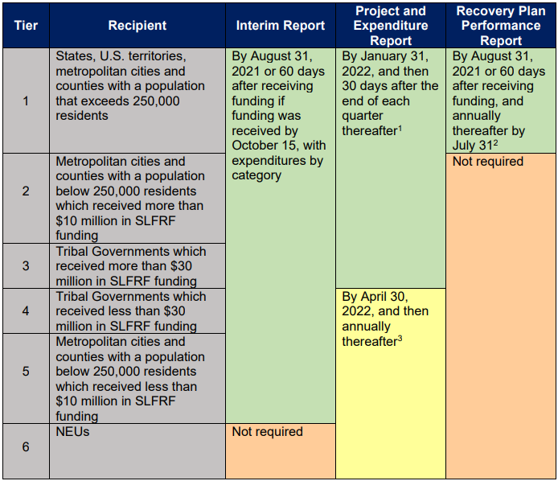
Recipient Tiers

Slide 4
Resources
Final Rule Summary
**Project and Expenditure Report - submission of the Project and Expenditure Report
Reporting Tiers - overview of each reporting tier and how to identify the reporting tier for a jurisdiction
**Account Creation and Login - creation of account in Treasury’s Portal through ID.me or Login.gov
User Roles - assignment and updates of user roles in Treasury’s Portal
Bulk Uploads - overview of submitting bulk uploads in Treasury’s Portal
Interim Report and Recovery Plan- submission of Interim Reports and Recovery Plans using Treasury’s Portal

Slide 5
Treasury’s Disclaimer
Recipients should note that Treasury does not pre-approve specific projects under the Coronavirus State and Local Fiscal Recovery Funds; each recipient should review the final rule to make its own assessment of whether its intended projects meets the eligibility criteria in the rule. (Submitted 2021 Interim Reports)
According to a January 2022 presentation, “Treasury will issue additional reporting guidance ahead of reports due April 30” (slide 24).

Slide 6
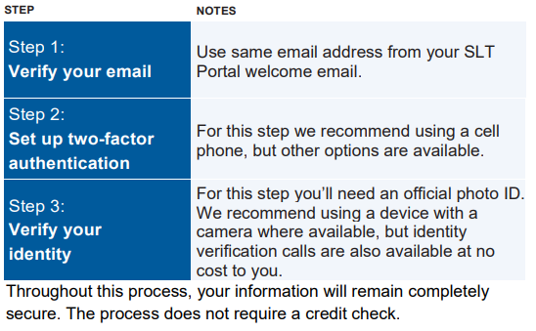
Treasury’s Portal is OPEN, but not live
Account Creation @ ID.me
Three Steps
Verify your email
Set up two-factor authentication
Verify your identify
Treasury’s American Rescue Plan Reporting and Compliance Portal
User Guide

Slide 7
Reporting - User Roles
Account Administrator has the administrative role of maintaining the names and contact information of the designated individuals for reporting. The Account Administrator is responsible for making any changes or updates to the user roles as needed over the award period. We recommend that the Account Administrator identify an individual to serve in his/her place in the event of staff changes.
Point of Contact for Reporting is the primary contact for receiving official Treasury notifications about reporting, including alerts about upcoming reporting, requirements and deadlines, and is responsible for completing reports.
Authorized Representative for Reporting or ARR is responsible for certifying and submitting official reports on behalf of the recipient. Treasury will accept reports or other official communications only when submitted by the Authorized Representative for Reporting.
** The same person can serve all three roles** Wise to have at least two with authorization**

Slide 8
SLT Portal Landing Page
https://api.id.me/en/session/new

Slide 9
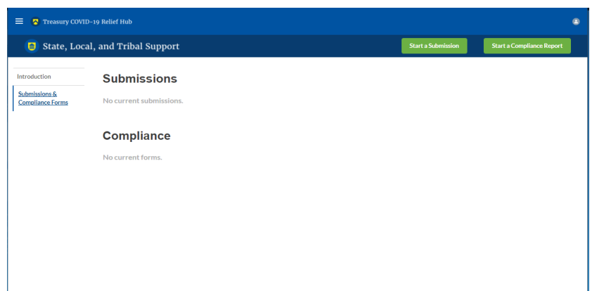
Successful Login! Look on the Left Panel.

Slide 10
Project and Expenditure Report **User Guide**
The first Project and Expenditure Report for Non-Entitlement Units of government (NEUs) will be due to Treasury by April 30, 2022, covering the period from March 3, 2021 to March 31, 2022.
MMA’s analysis suggests that towns, cities, and villages might benefit from not spending any of their ARPA funds until after March 31, 2022 (the end of the first reporting period), if possible. This will provide the time to see if additional clarification (through an updated Treasury FAQ) and/or guidance will be released by Treasury.

Slide 11
Project and Expenditure Report Modules
Recipient Profile
Project Overview
Subrecipients/Beneficiaries
Subawards/Direct Payments
Expenditures
Recipient Specific
Certification

Slide 12
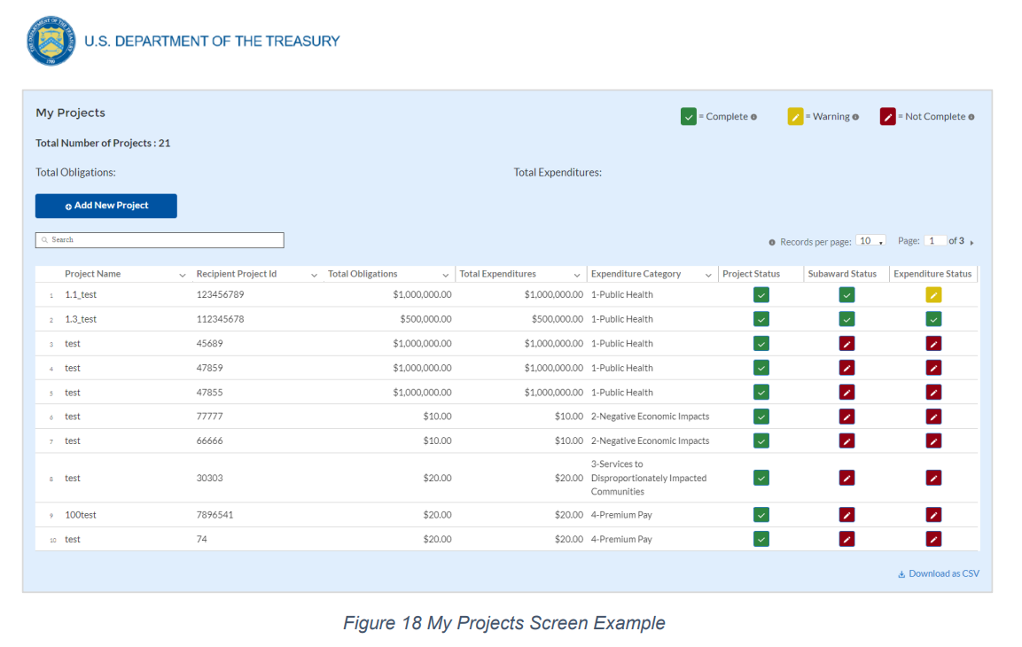
“My Projects” Screen

Slide 13
Programmatic Data for Projects
Projects in several expenditure categories require programmatic data in addition to the standard project information.
Appendix D provides detail on the measures and information required by expenditure category.
Generally speaking, more specifics are needed for infrastructure (water, sewer, broadband) projects and expenditures with higher price-tags (greater than $50,000)

Slide 14
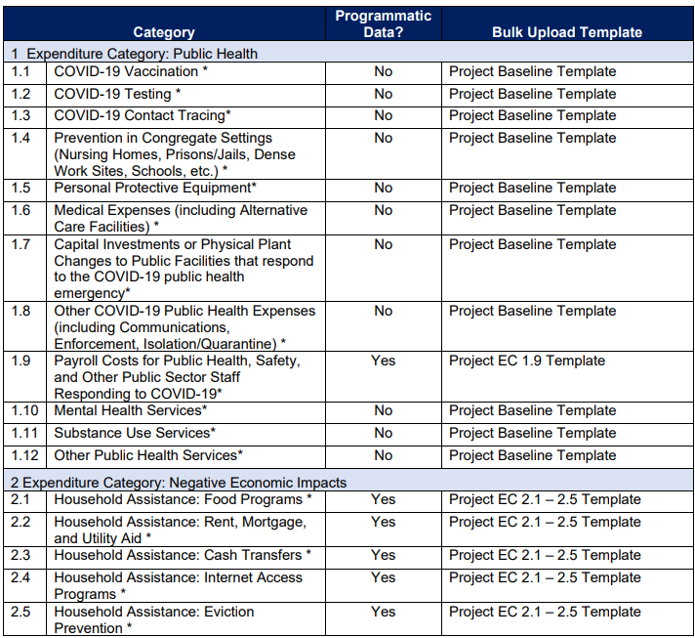

Slide 15
“No Projects” Option
If your jurisdiction has not yet identified any projects to report, please know that maintaining a project list is a core reporting requirement.
For the Project and Expenditure Report, in the event recipients have no projects available for entry, select “No Projects Available” in lieu of adding projects not otherwise
To utilize this option, on the Add Project screen
Select “No Projects Available” from the Project Expenditure Category Group
Select “No Projects Available” from the Project Expenditure Category
Enter in a Project Name of your choosing
Enter a description as to the rationale for no projects being available for reporting

Slide 16
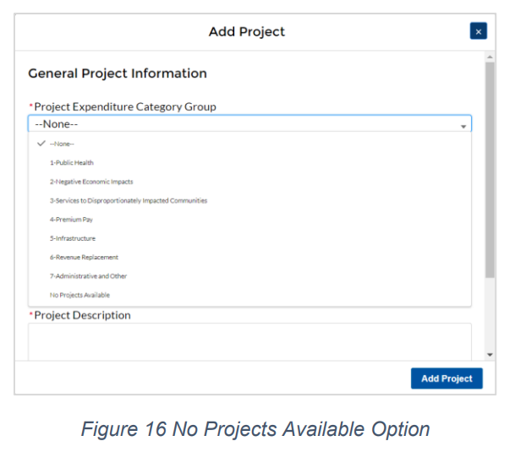
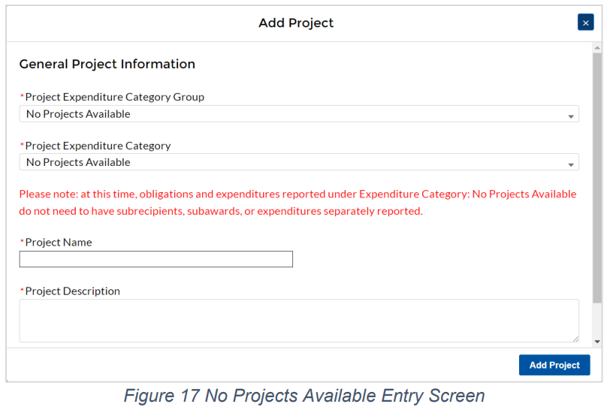
“No Projects” Option (cont.)

Slide 17
Programmatic Data: Premium Pay(Example)

Slide 18
Revenue Loss & the “Standard Allowance”
As outlined in the final rule, Recipients will have the option to make a one-time decision to calculate revenue loss according to the formula outlined in the final rule or elect a “Standard Allowance” of up to $10 million, not to exceed the award allocation, to spend on government services throughout the period of performance.
“Is your jurisdiction electing to use the standard allowance of up to $10 million, not to exceed your total award allocation, for identifying revenue loss? Yes/No (Please note electing the standard allowance does not change your total allocation).”
If computing revenue loss using Treasury’s formula, recipients are permitted to choose whether to use calendar or fiscal year calculation dates.

Slide 19
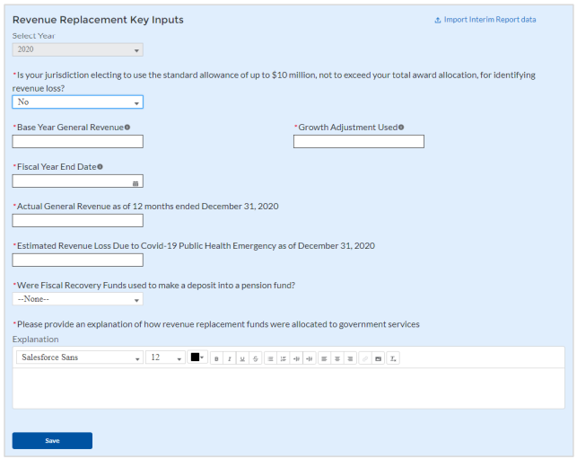
Programmatic Data: Revenue Loss (Example)

Slide 20
Tips to Prepare for Reporting
Record and document as much as possible:
Instances of community engagement
Public comment periods, input, applications
Decision making process
Procurement, bidding, and contracting process
Amount obligated, amount expended, and % complete
Invoices, receipts
Justification narratives
What is the pandemic-related impact being addressed?
How will/did the expenditure address the impact?
Provide a description for the project between 50 to 250 words.
Treasury encourages recipients to include a description of the population they are serving, the desired impact, and how this impact will be measured.
Dates/timeline

Slide 21
Thank you & Questions
Neal Goldberg
Legislative Advocate
State and Federal Relations
ngoldberg@memun.org
207-623-8428 x2208

